Slide 1
Variable impacts to final math scores
Daniel corral
Dsc 530

Slide 2
I hypothesize that that alcohol use has a large impact on student’s final math grades. I also think the number of absences will have a large impact. I also think parental education will have a significant impact on grades as well.
Weekday alcohol consumption seems like it would impact grades more than weekend. I do not believe that family size will have much of an impact.
I think exploring some of these impacts will give a good picture of what external factors play a part in determining math grade performance.

Slide 3
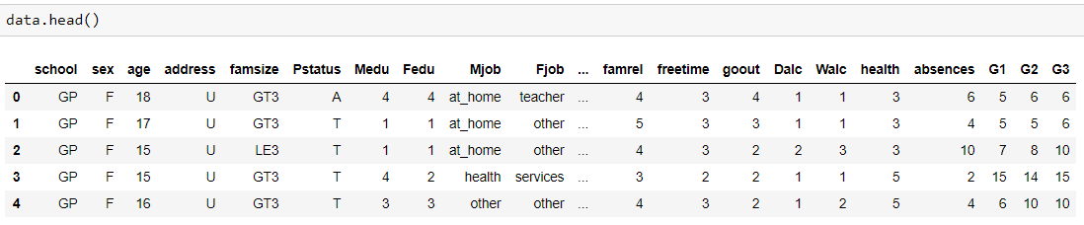
using the following dataset - https://www.kaggle.com/janiobachmann/math-students, i hope to solve for my hypothesis. This dataset is called student-mat.csv and contains the final math scores of students in secondary school. This dataset was interesting to me because it has a lot of different variables that can be tested to see whether it is apparent that they are impacting the final grade.

Slide 4
My data
The dataset I used consisted of 396 rows with 33 variables
The datatypes varied between actual numeric values, representative numeric values, text values, and representative Boolean values
This is a very small dataset so we will see how it affects the results of the analysis.

Slide 5
The main variables I am interested in are:
final score (g3)
mother’s education (medu)
Father’s education (fedu)
Absences
gender (sex)
family size (famsize)
Weekday alcohol consumption (dalc)
Weekend alcohol consumption (walc)

Slide 6
Average scores
Overall average score – 10.4
Males – 10.9
Females – 10.0
High Parental education – 11.6
Low parental education – 10.3
High weekday alcohol use – 10.1
High weekend alcohol use – 10.0
LOW weekday alcohol use – 11.0
LOW weekend alcohol use – 11.2
High family size – 10.8
Low family size – 11.3

Slide 7
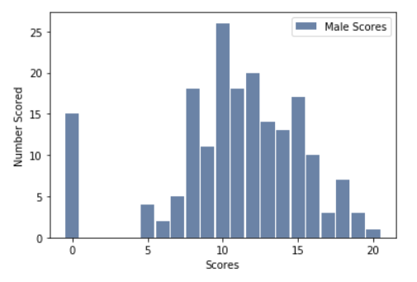

Slide 8
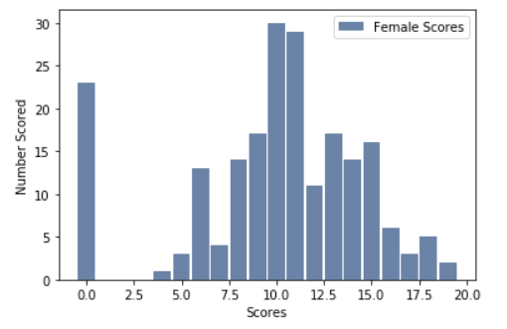

Slide 9
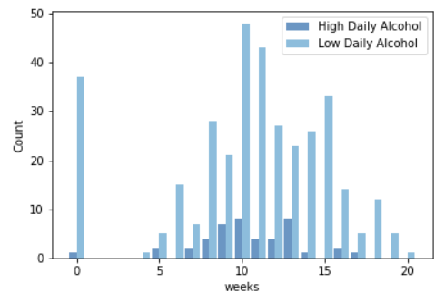

Slide 10
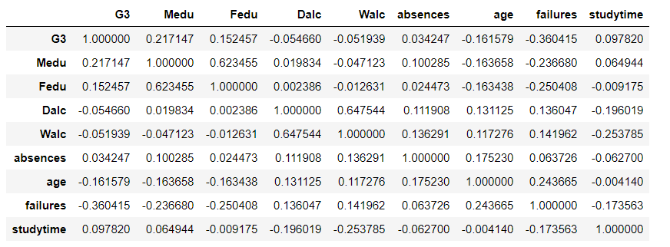
Correlation

Slide 11
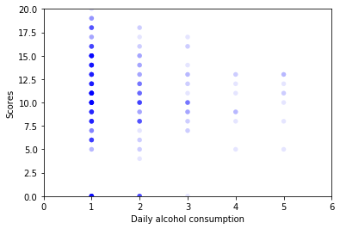
Scatterplot daily alcohol consumption

Slide 12
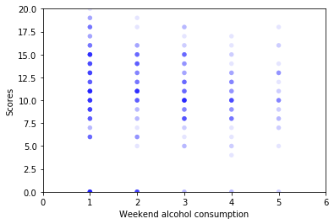
Scatterplot weekly alcohol consumption

Slide 13
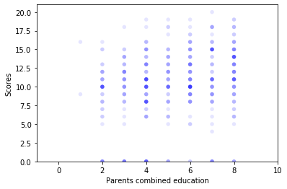
Scatterplot parent’s combined education

Slide 14
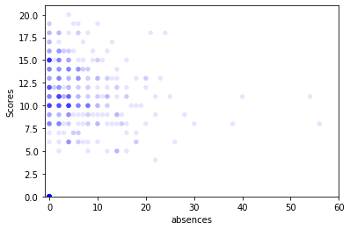
Scatterplot absences

Slide 15
Through correlation and visualization of it with scatterplotting, it appears there is not even a moderate correlation with any of the variables other than previous failures.
According to the analysis, these external variables would have little impact on math scores.
I do not agree with the finding as I believe this analysis was severely limited by the size of the dataset.
I do not believe this dataset would represent any large population group based upon findings. I would recommend several separate datasets with at least 3000 cases.

Slide 16
reference
P. Cortez and A. Silva. Using Data Mining to Predict Secondary School Student Performance. In A. Brito and J. Teixeira Eds., Proceedings of 5th FUture BUsiness TEChnology Conference (FUBUTEC 2008) pp. 5-12, Porto, Portugal, April, 2008, EUROSIS, ISBN 978-9077381-39-7.

